Slide 1
DALRRD: NATIONAL SANITARY AND PHYTOSANITARY WORKSHOP
Overview of Food Control in the context of the Foodstuffs, Cosmetics And Disinfectants Act,1972 (Act No. 54 Of 1972)
Malose Daniel Matlala
Directorate: Food Control
10 March 2021

Slide 2
WHAT IS FOOD CONTROL (WHO)
“A mandatory regulatory activity of enforcement by national or local authorities to provide Consumer Protection and ensure that all foods during production, handling, storage, processing and distribution are Safe, Wholesome and Fit for Human Consumption; conform to Quality and Safety requirements; and are honestly and accurately Labelled as prescribed by law”

Slide 3
National
Provinces
Assignees
South African Food Control System
National
MUNIs
DALRRD
QA & Export of Regulated agricultural products
Registration of pesticides & stock remedies
Meat Hygiene, Import & Export of fresh meat etc
SPS Enquiry Point
DoH
Import, Manufacture, Sale & Export (“Processed Products”)
“Food Safety Regs”
Nutritional Labelling
CODEX Contact Point
INFOSAN Emergency Contact Point
RASFF Contact Point
dti
NRCS
Canned and
frozen fish/products
Fresh seafood
Canned meat products (>10%)
Imports & Certification of exports
SABS
TBT Enquiry Point
VOLUNTARY Standards
SANAS
NCC
Co-Ordination, Collaboration, Communication
Consumer Protection Act, 2008 ---NCC
Monitor the Consumer Market, investigate alleged prohibited conduct and offences and enforce compliance notices
Notes:
In countries where authorities dealing with food safety are located in several agencies, several focal points have been identified.
In this context, food safety authorities are broadly defined and include authorities involved in
- food legislation,
- risk assessment,
- food control and management,
- food inspection services, laboratory services for monitoring and surveillance,
- food safety information, - trade officials, veterinary services
- and education and communication, across the entire farm-to-table continuum.
Currently, INFOSAN Focal Points are located in several ministries, including ministries of health, food, agriculture and trade. When there is more than one focal point in a country, the coordination between the focal points must take place at the country level to ensure that the roles are undertaken effectively.

Slide 4
HEALTH’S FOOD CONTROL LEGISLATION: DEPARTMENT OF HEALTH (DOH)
Foodstuffs Cosmetics and Disinfectants Act, (Act 54 of 1972):
  To control the Sale, Manufacture, Importation and Exportation of Foodstuffs, Cosmetics and Disinfectants; and to provide for incidental matters
  Administered by the Directorate: Food Control at national level
  Control of imported foodstuffs by National (3 Regions)
  Enforcement of local market/foodstuffs by 52 Metro/ District Municipalities
  A number of Regulations arranged in 12 Categories –all available on our webpage

Slide 6
IN SUMMARY
Forbid sale of F, C & D that may be detrimental/harmful to health
Endeavours to protect consumer from exploitation by false / misleading claims
Attempts to provide consumer with information – make informed choices

Slide 7
PHILOSOPHY (1) REACTIVE
Places onus on:
Manufacturer/Seller and Importer to comply
Law enforcer to establish whether product complies (Enforcer reacts to particular situation)
Provides for approval & stipulation of max levels of certain ingredients to be used e.g. food additives, MRLs

Slide 8
PHILOSOPHY (2) PROHIBITIVE
Nothing added/removed unless permitted (E.g. Sudan Red)
Substances allowed shall:
  Non injurious/harmful
  Present in minimum amounts
  Comply to standard of composition, strength, purity, quality
Unavoidable presence of foreign substance: (e.g. Melamine-) present if permitted at specific level

Slide 9
PRINCIPAL STAGES OF FOOD SUPPLY
SUPPLY OF AGRICULTURAL INPUTS (fertilizers, pesticides, feeding)
PRIMARY PRODUCTION (farmers, fisherman, fish farmers)
PRIMARY FOOD PROCESSING (on-farm, dairies, abattoirs, grain mills)
SECONDARY FOOD PROCESSING(canning, freezing, drying, brewing)
FOOD DISTRIBUTION (national/international, import/export)
FOOD RETAILERS
FOOD CATERING
CONSUMERS

Slide 10
STAGES OF FOOD SUPPLY ? FCD LEGISLATION
SUPPLY OF AGRICULTURAL INPUTS (fertilizers, pesticides, feeding)
GAP
PRIMARY PRODUCTION (farmers, fisherman, fish farmers)
GAP
FCD
PRIMARY FOOD PROCESSING (on-farm, dairies, abattoirs, grain mills)
FCD
SECONDARY FOOD PROCESSING(canning, freezing, drying, brewing)
FCD
FOOD DISTRIBUTION (national/international, import/export)
FCD
FCD
FOOD RETAILERS
FOOD CATERING
IEC
CONSUMERS

Slide 11
Which Regulations Apply at Primary Food Processing: HYGIENE
PRIMARY FOOD PROCESSING (on-farm, dairies, abattoirs, grain mills)
Milking Sheds R 991/2012
A dairy/milking shed must comply and have a Certificate of Acceptability
Milk & Milk Products R 1555/1997
Microbiological safety of milk & milk products, including raw milk
Sale of raw milk
Microbiological Criteria R 692/1997
Certain agricultural products e.g. Tea, sugar
Hygiene Regulations R 962/2012
– A food premises must have Certificate of Acceptibility (CoA)
Primary Agricultural products are exempted from a CoA unless Processing takes place (packing, washing, packaging, cutting , drying etc)
Abbatoir-If products are being sold/further processed
HACCP Regulations R 908/2003
Only one sector has been listed for regulatory HACCP:
Anyone sorting or grading groundnuts must have HACCP Certification issued in terms of the Regulations

Slide 12
Which Regulations Apply at Primary Food Processing: Chemicals & Labelling
PRIMARY FOOD PROCESSING (on-farm, dairies, abattoirs, grain mills)
CHEMICAL
Pesticide Residues R246/1994 & Amendments
Veterinary Residues –R 1809/1992 Mycotoxins R 1145/2004 -- Storage
Preservatives- R965/1997
cutting
Seed Tolerances R 1225/2002
Heavy Metals R 1518/1994
LABELLING
Labelling & Advertising R 146/2010 & its Amendments - packaging but subject to APS,1990

Slide 13
Which Regulations Apply at Secondary Food Processing: HYGIENE
SECONDARY FOOD PROCESSING(canning, freezing, drying, brewing)
Hygiene Regulations R 962/2012
– The food premises must have Certificate of Acceptability
Processing takes place (packing, washing, packaging, cutting , drying etc)
Dairy-Pasteurisation, Yoghurt making
Farm-Atchar
HACCP Regulations R 908/2003
No sectors listed

Slide 14
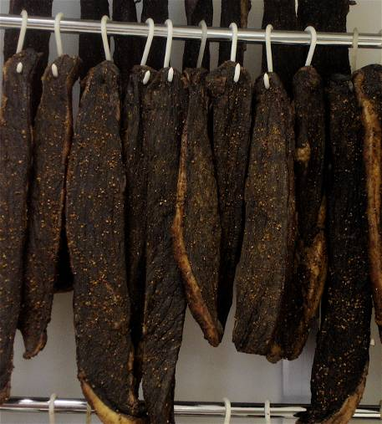
Which Regulations Apply at Secondary Food Processing: Chemicals & Labelling
SECONDARY FOOD PROCESSING(canning, freezing, drying, brewing, milling)
CHEMICAL
Pesticide Residues R246/1994 & Amendments
Veterinary Residues –R 1809/1992 For Veterinary Drugs and Stock Remedies
Mycotoxins R 1145/2004 --
Preservatives & Antioxidants- R965/1997
Heavy Metals R 1518/1994
Colourants R 1008/1996
Emulsifiers
Jams, Conserves, Marmalades and Jelly R 2627/1986
Packaged Waters R 718/2006
PROHIBITION: Comfrey R 1408/2003
LABELLING
Labelling & Advertising R 146/2010 & its Amendments - packaging but subject to APS,1990
Fortification R 504/2003

Slide 15
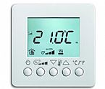
Which Regulations Apply at Food Distribution/Transport : HYGIENE
FOOD DISTRIBUTION (national/international, import/export)
Hygiene Regulations R 962/2012
– A food premises must have Certificate of Acceptibility
Any vehicle used for transport of food
Temperature Controls -(Perishable Products)
HACCP Regulations R 908/2003
No sectors listed
Milk & Milk Products R 1555/1997
Microbiological safety of milk & milk products, including raw milk
Sale of raw milk
Transport of Milk- Milking Sheds Regulations R 961/2012

Slide 16
Which Regulations Apply at Primary Food Processing: HYGIENE
FOOD RETAILERS ( can be Farmers as well in terms of definition of “SELL” in the Act!
Hygiene Regulations R 962/2012
– The farm stall/van is also a food premise if selling processed agricultural products & must have Certificate of Acceptibility
HACCP Regulations R 908/2003
Not listed as a Sector as yet
Milk & Milk Products R 1555/1997
Microbiological safety of milk & milk products, including raw milk
Sale of raw milk
Microbiological Criteria R 691/1997
RTE foods

Slide 17
Which Regulations Apply at Primary Food Processing: Chemicals & Labelling
FOOD RETAILERS ( can be Farmers as well in terms of definition of “SELL” in the Act!
CHEMICAL
Pesticide Residues R246/1994 & Amendments
Veterinary Residues –R 1809/1992
Mycotoxins R 1145/2004 -
Preservatives- R965/1997
Seed Tolerances R 1225/2002
Heavy Metals R 1518/1994
LABELLING
Labelling & Advertising R 146/2010 & its Amendments - packaging but subject to APS,1990

Slide 18
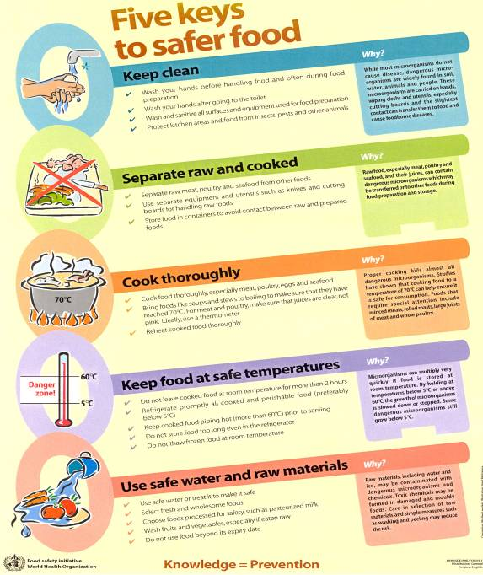


The Five Keys to Safer Food For Food Handlers & Consumers
Action
Department of Food Safety, Zoonoses, and Foodborne Diseases, World Health Organization
Notes:
The Five Keys are:
Keep Clean
Separate Raw and Cooked Foods
Cook Food Thoroughly
Keep Food at Safe Temperatures
Use Safe Water and Raw Materials
The Five Keys poster has been translated into over 50 languages. If materials in another language are needed, arrangements for translation can be made through WHO Headquarters or the regional and country offices.

Slide 19
Thank You!!!
Ke ya leboga
Ke a leboha
Ke a leboga
Ngiyabonga
Ndiyabulela
Ngiyathokoza
Ngiyabonga
Inkomu
Ndi khou livhuha
Dankie

